Slide 1
Week 3: Project Planning

Slide 2
Software Requirements

Slide 3
What is a Software Requirement?
“A requirement is a condition or capability that is necessary to be present in a product, service, or result to satisfy a need.”
Sources of requirements can be from stakeholders, contracts, policies, standards, or regulations.

Slide 4
Software Requirements Activities
Elicitation
Asking the stakeholders what they need
Analysis
Breaking down the answers into specific needs
Specification
Documenting what the end result should look like
Validation
Asking the stakeholders if the specification would meet their needs
Management
Developing a process to deal with changes in requirements

Slide 5
Elicitation
Elicitation is the gathering and discovery of requirements from stakeholders and other sources
A variety of techniques can be used such as
Joint Application Design (JAD) sessions
Interviews
Document analysis
Focus groups
Elicitation is the first step of requirements development

Slide 6
Analysis
Analysis is the logical breakdown that proceeds from elicitation
Analysis involves reaching a richer and more precise understanding of each requirement and representing sets of requirements in multiple, complementary ways

Slide 7
Specification
Specification involves representing and storing the collected requirements knowledge in a persistent and well-organized fashion that facilitates effective communication and change management
Use cases, user stories, functional requirements, and visual analysis models are popular choices for requirements specification
Notes:
Use cases: A use case is a concept used in software development, product design, and other fields to describe how a system can be used to achieve specific goals or tasks. It outlines the interactions between users or actors and the system to achieve a specific outcome. (https://www.wrike.com/blog/what-is-a-use-case/)
User stories: A user story is the smallest unit of work in an agile framework. It’s an end goal, not a feature, expressed from the software user’s perspective. (https://www.atlassian.com/agile/project-management/user-stories)
functional requirements: product features or functions that developers must implement to enable users to accomplish their tasks. So, it's important to make them clear both for the development team and the stakeholders. Generally, functional requirements describe system behavior under specific conditions. (https://qracorp.com/guides_checklists/functional-vs-non-functional-requirements/?utm_source=ppc&utm_medium=google&utm_campaign=hl&utm_term=tof&utm_campaign=HL_TOF_jul-11-23&utm_term=what%20are%20functional%20requirements&utm_source=adwords&utm_medium=ppc&hsa_tgt=kwd-468673299085&hsa_ad=665303059423&hsa_grp=147981466021&hsa_src=g&hsa_cam=20353680222&hsa_mt=e&hsa_net=adwords&hsa_acc=2231427534&hsa_kw=what%20are%20functional%20requirements&hsa_ver=3&gclid=CjwKCAjwpJWoBhA8EiwAHZFzfoYuBMRz1FGZF5fUCf1Js1KJVhXHyap_I3_ZytEJA-JS8xJ3_LFWeBoCtK0QAvD_BwE)
visual analysis models: Visual modeling is the use of semantically rich, graphical and textual design notations to capture software designs. A notation, such as UML, allows the level of abstraction to be raised, while maintaining rigorous syntax and semantics. (https://www.utm.mx/~caff/doc/OpenUPWeb/openup/guidances/concepts/visual_modeling_2C089766.html#:~:text=Visual%20modeling%20is%20the%20use,maintaining%20rigorous%20syntax%20and%20semantics.)

Slide 8

Validation
Validation involves techniques to confirm that the correct set of requirements has been specified to build a solution that satisfies the project's business objectives.

Slide 9

Management
Requirements change during projects and there are often many of them.
Management of this change becomes paramount to ensuring that the correct software is built for the stakeholders.
Project manager
Stakeholders with a requirement change

Slide 10
Business Analysis
Business analysis is a professional discipline^{[1]} of identifying business needs and determining solutions to business problems.
The person who carries out this task is called a business analyst or BA.^{[2]}
Notes:
Business needs are the opportunities that are of strategic importance to our organization. When an issue is encountered in an organization, such as a series of customer complaints, a decrease in revenue, new market opportunities, we see business needs in action. (https://www.linkedin.com/learning/business-analysis-foundations-enterprise)
Business Analysis can be understood as a research discipline that helps you to find the business needs and identify solutions to business problems. These solutions may include the development of a software or system component, improvements in process, organizational changes or strategic planning and policy development. (https://www.guru99.com/business-analysis-process-techniques.html#:~:text=Business%20Analysis%20can%20be%20understood,strategic%20planning%20and%20policy%20development.)

Slide 11
Business Analyst Responsibilities
To investigate business systems, taking a holistic view of the situation.
To evaluate actions to improve the operation of a business system.
To document the business requirements for the IT system support using appropriate documentation standards.
Notes:
A business system is a defined set of principles, practices and procedures that are applied to specific activities to achieve a specific result. Basically, it's about creating a set of shortcuts that will make sure everything still gets done right. (https://www.myob.com/au/blog/understanding-business-systems/#:~:text=What%20is%20a%20business%20system,everything%20still%20gets%20done%20right.)

Slide 12
Work Breakdown Structure

Slide 13
What is a WBS?
A work breakdown structure is a key project deliverable that organizes the team's work into manageable sections.
The Project Management Body of Knowledge (PMBOK 5) defines the work-breakdown structure as a "hierarchical decomposition of the total scope of work to be carried out by the project team to accomplish the project objectives and create the required deliverables."

Slide 14
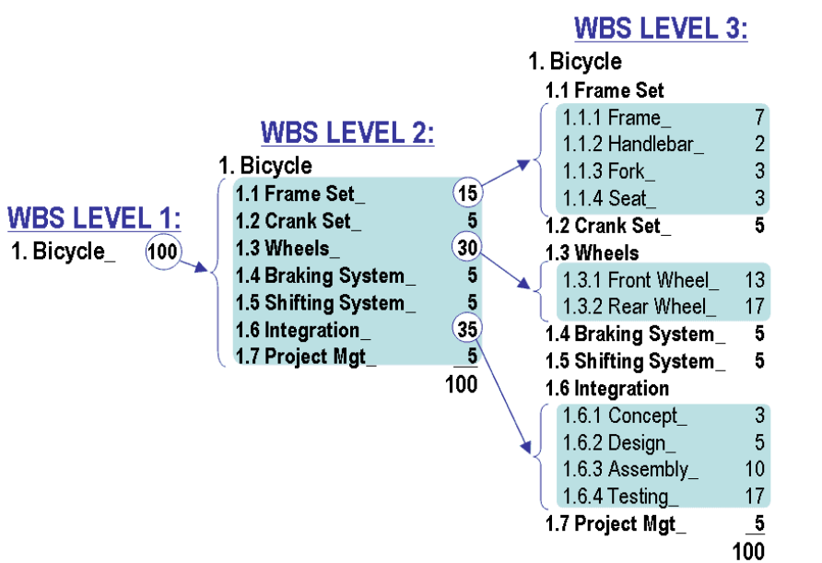
WBS Example
https://www.projectmanagement.com/deliverables/311164/bicycle-work-breakdown-structure--wbs--example
More explanation:
https://unito.io/blog/work-breakdown-structure/

Slide 15
RAID – Risks, Actions, Issues, Decisions

Slide 16
Risks
A risk is something that we are worried about in the future.
It may or may not happen.
Examples:
We may have to change more code than we thought.
We might lose a resource.
The test environment may not be ready in time.
The materials may not be of the quality we need.

Slide 17
Actions
Actions are different from tasks, they are short finite todo items that are assigned to one person.
Often identified and assigned to a team member during a meeting.
Can you think of some examples?

Slide 18
Issues
An issue is something of concern in the present.
It's happening now.
Examples:
We need a decision made on which software version to use.
We don't know how the employee address should be stored.
We don't have anyone who knows JAVA.
The response time is so slow that we can't get our test cases entered.

Slide 19
Decisions
Whenever a decision is made, a project manager should consider if the decision is one that will be important in the future, or will be meaningful to others.
It is generally best to include every decision at first because it can be difficult to know for certain which decisions will need to be referred to in the future, or what decisions may need revising.
Example: https://pmipicks.pmi.org/content-page/0c01287f-7e48-447a-a8a1-13e468920eae This link isn’t working, so will use “RAID log example.xlsx” in Brightspace instead
Notes:
Download decision log and go through it with students

Slide 20
Questions?

Slide 21
Release info
Release: 2023-09-20
Author: Melissa Sienkiewicz
Credits/References:
PMBOK® Guide (2021)
Business Analysis for Practitioners: A Practice Guide (2015).
https://en.wikipedia.org/wiki/Software_requirements
https://en.wikipedia.org/wiki/Business_analysis
https://en.wikipedia.org/wiki/Work_breakdown_structure
https://www.pmi.org/learning/library/risks-issues-changes-forms-logs-1078
https://pmipicks.pmi.org/content-page/0c01287f-7e48-447a-a8a1-13e468920eae

